Slide 1
Lead User Guide:
Create New Training Program
Updated: 01/04/2019
Notes:
Welcome to the online tutorial for the Lead program’s Training Provider Accreditation application. This tutorial will walk you through the process of completing a New Training Program application.

Slide 2
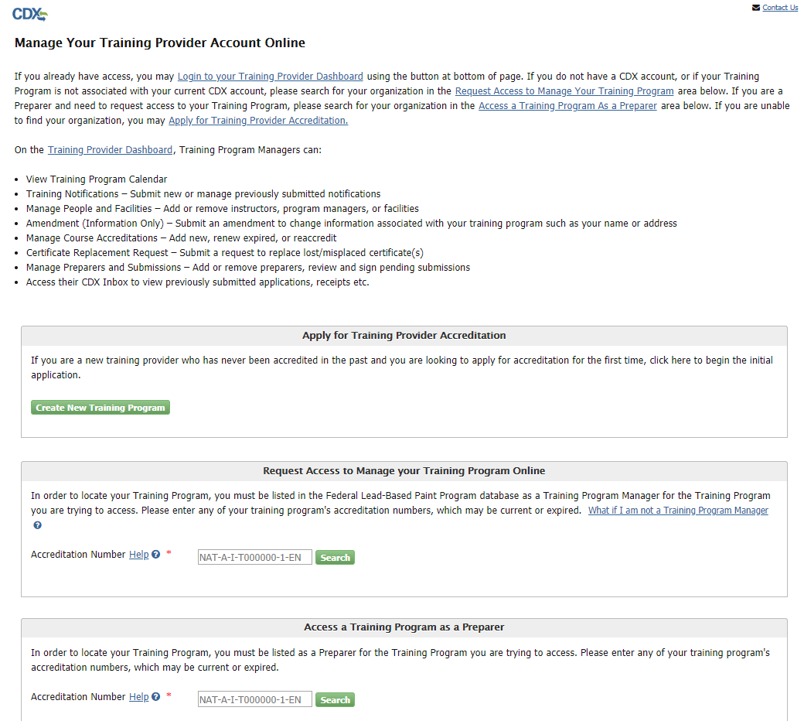
New Training Program
https://cdx.epa.gov/XCDX/LeadTpCertification/Public
Notes:
Users can create a new Training Provider Dashboard by navigating to the Training Provider Public Site, located at https://cdx.epa.gov/XCDX/LeadTpCertification/Public. Users click “Create New Training Program” to create a new Dashboard.

Slide 3
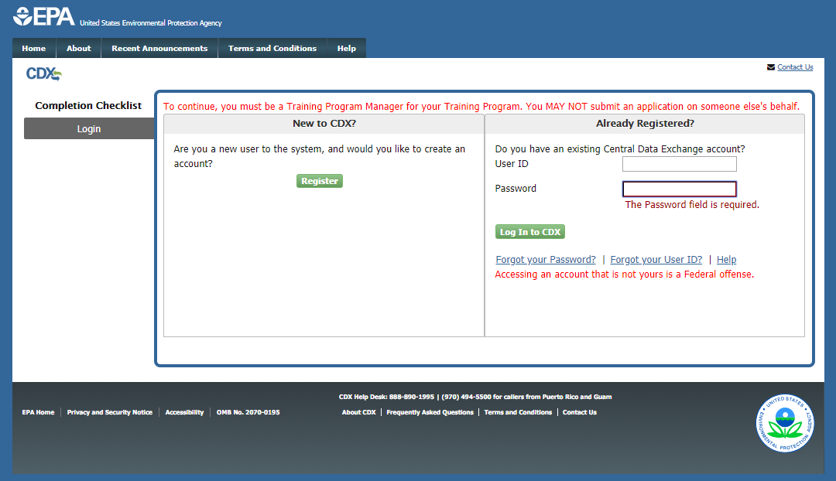
New Training Program
Notes:
You will be directed to the CDX Log In/Registration page. If you have previously used the Central Data Exchange for reporting, enter your CDX username and password and click the “Log In to CDX” button. If you have forgotten your username or password, click the appropriate link and follow the steps provided to recover your information. If you are new to CDX, click the “Register” button to create a new account.

Slide 4
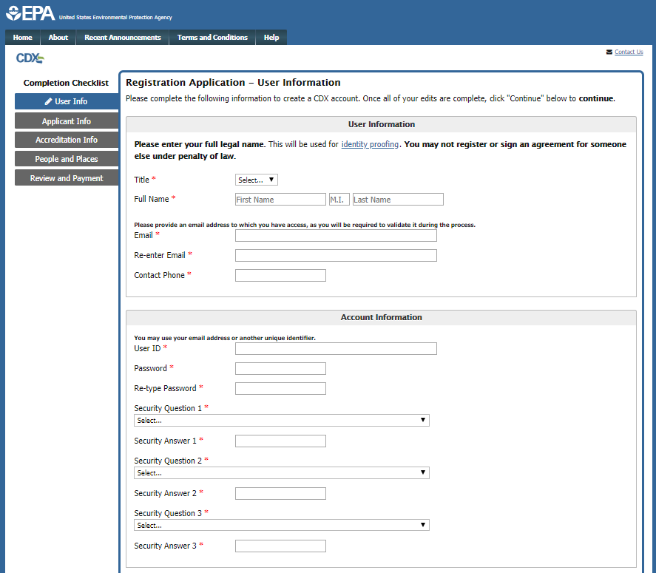
New User Registration - User Information
Notes:
You must fill out the User Information page to create your CDX account as the first part of the application process. Enter the appropriate information in the fields in this section; please use your full legal name in the Full Name fields as this will be used for electronic identity proofing later in the process. For more information on the identity proofing process, click the ‘Identity proofing’ link. Create a User ID and Password for CDX by entering a unique identifier in the User ID field; this may be your email address or another screen name. Do not use your social security number as your user ID. Be sure to remember the password you choose; you will need to enter it later in order to sign your application. Select three security questions and enter answers for each that you will remember but are hard to guess.

Slide 5
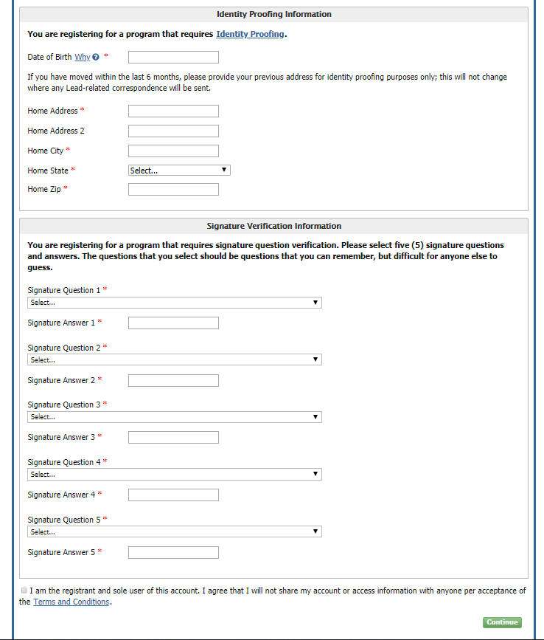
New User Registration - User Information
Notes:
Complete the Identity Proofing Information section then select five signature verification questions and enter answers for each that you will remember but are hard to guess. Before continuing, click the link to open and carefully read the Terms and Conditions of the CDX system. Select the check box to agree to the Terms and Conditions before clicking “Continue.”

Slide 6
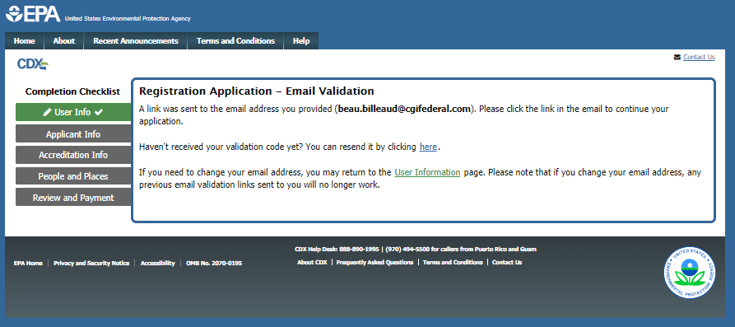
Email Validation
Notes:
Once you complete the account and user Information, an email will be sent to the email address you’ve provided. Please check for the email, and click the link to validate your email.

Slide 7
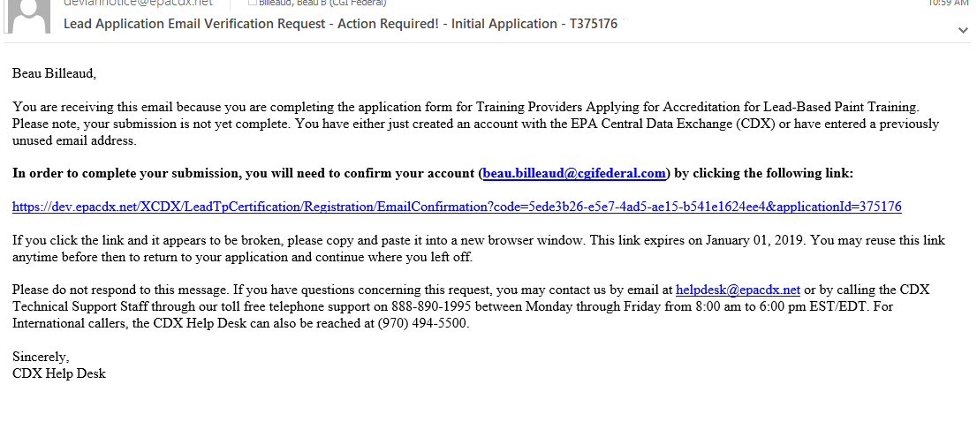
Email Validation
Notes:
This is an example of the email you will receive. Click the link provided to validate your email and continue with the training provider application.

Slide 8
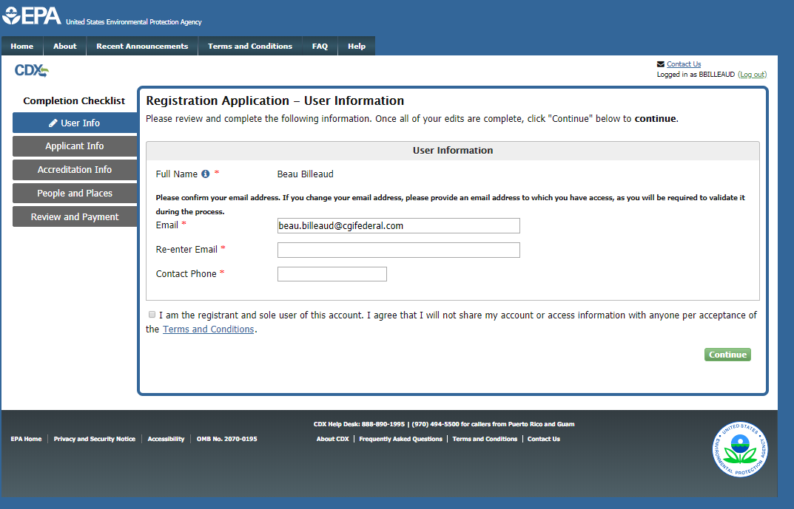
Existing CDX User - User Information
Notes:
If you are an existing CDX user and already have a CDX account, you will use the already registered login option instead of registering for a new account. You will be redirected to this page upon logging in where you will need to verify your email address and provide a contact phone number. Before continuing, click the link to open and carefully read the Terms and Conditions of the CDX system. Select the check box to agree to the Terms and Conditions before clicking “Continue.”

Slide 9
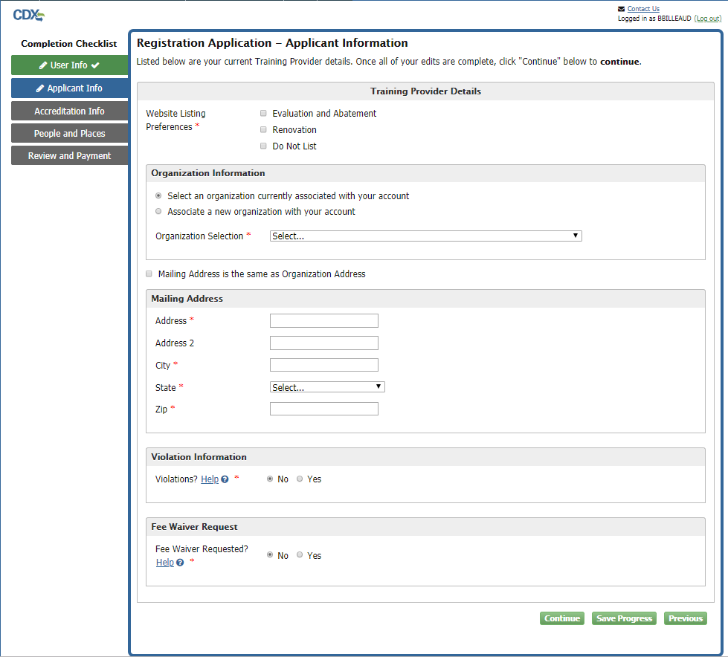
Applicant Information
Notes:
You will then be redirected to the Training Provider Details page to complete your organization information, address any violations and request a fee waiver if necessary.

Slide 10
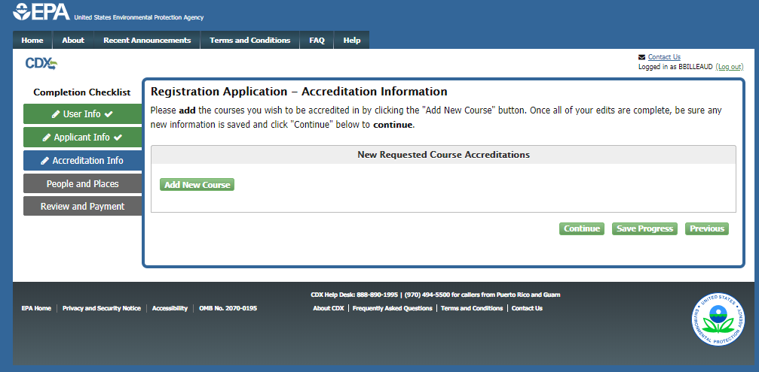
Accreditation Information
Notes:
Click “Add New Course.”

Slide 11
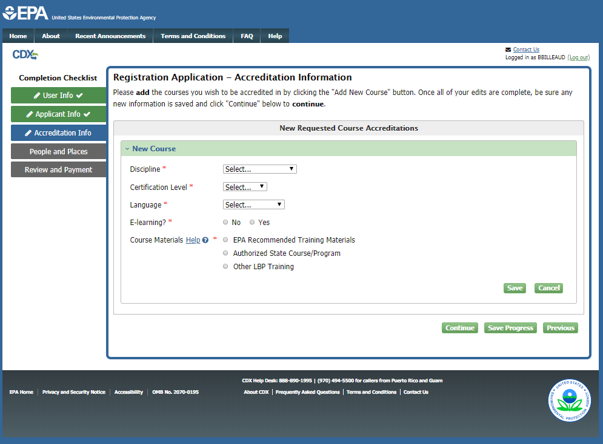
Accreditation Information
Notes:
Complete the accreditation information and click “Save”. Users can apply for additional accreditation by clicking “Add New Course.” Users may add as many courses as necessary before continuing with the application.

Slide 12
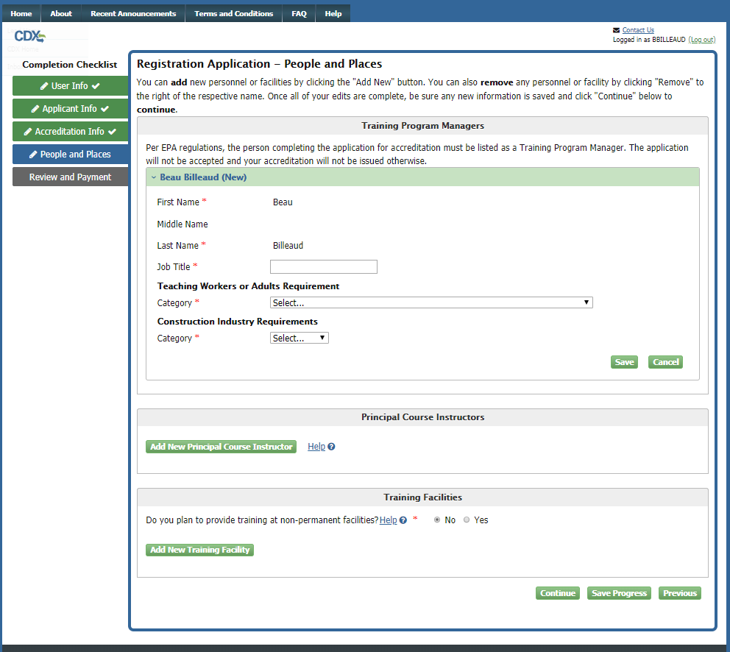
People and Places
Notes:
Per EPA regulations, the person completing the application for accreditation must be listed as a Training Program Manager. The application will not be accepted and your accreditation will not be issued otherwise. The name listed on the CDX user’s account will be pre-populated as the first Training Program Manager. Users can add additional Training Program Managers but the individual applying for the CDX account must be listed as a Training Program Manager to continue. On the People and Places page, users can add additional Training Program Managers by clicking the "Add New Training Program Manager" button. At this point, a user can also add Principal Course Instructors and Training Facilities. In the Training Facilities section, users can also elect to provide proper documentation if they plan to have training at non-permanent facilities.

Slide 13
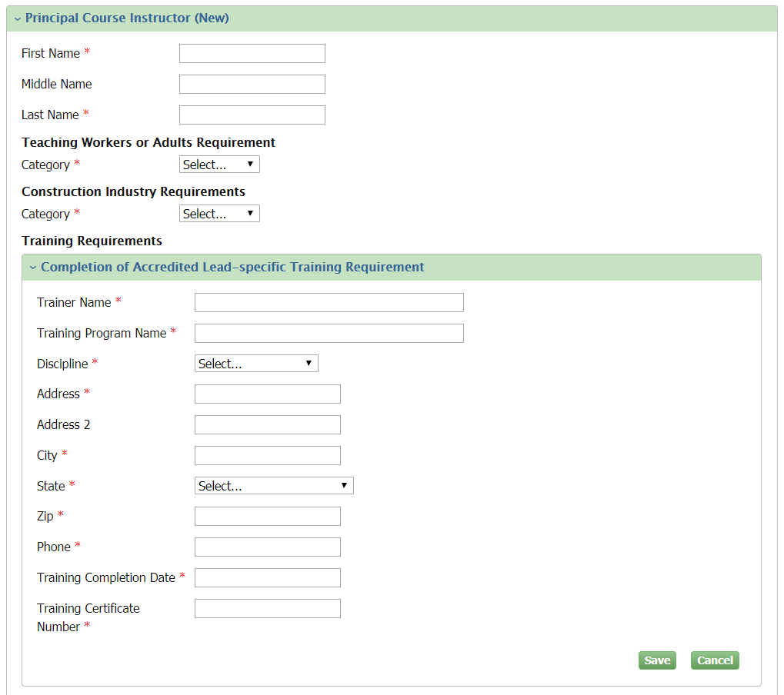
People and Places
Notes:
Clicking the "Add New Principal Course Instructor" button will expand the Principal Course Instructors section and the Training Requirements sub-section. A user can add/save multiple Training Requirements per Principal Course Instructor.

Slide 14
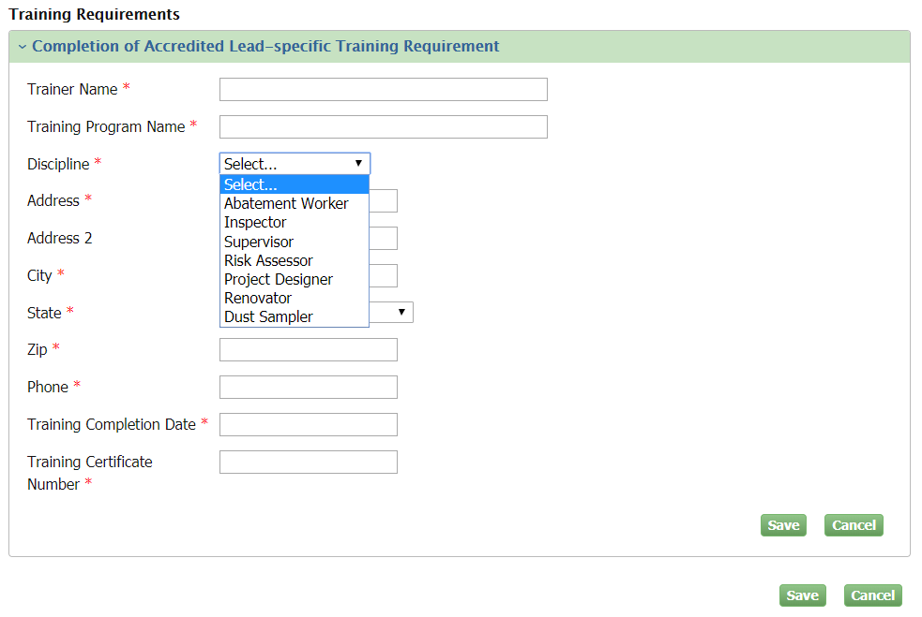
People and Places
Notes:
When adding a Training Requirement for a Principal Course Instructor, users will be able to select from multiple disciplines.

Slide 15
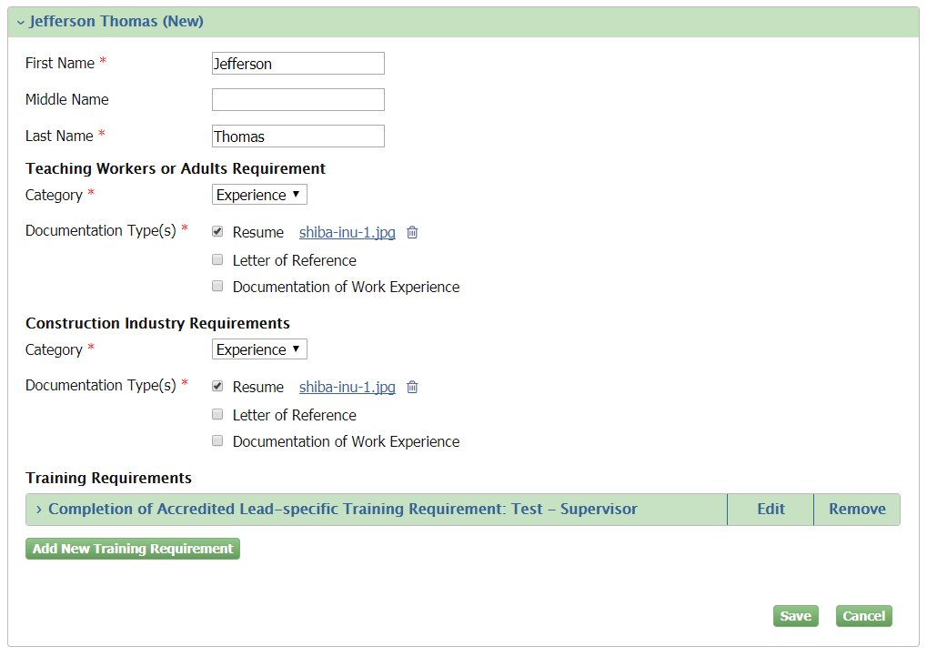
People and Places
Notes:
Clicking "Save" within Training Requirements will collapse the completed Training Requirements section. The user can then edit, remove, or add another new training requirement for that Principal Course Instructor.

Slide 16
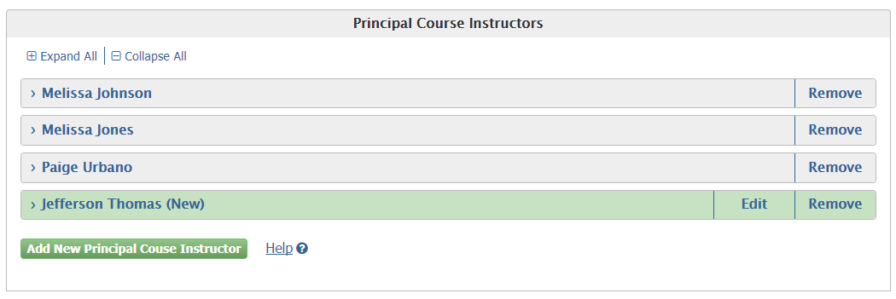
People and Places
Notes:
Clicking "Save" within the Principal Course Instructor section will save the Training Requirements and all other information added for that Principal Course Instructor. Saving the Principal Course Instructor will collapse the section and display as shown above. Users will have the ability to edit the newly added Principal Course Instructor up until the form is submitted.

Slide 17
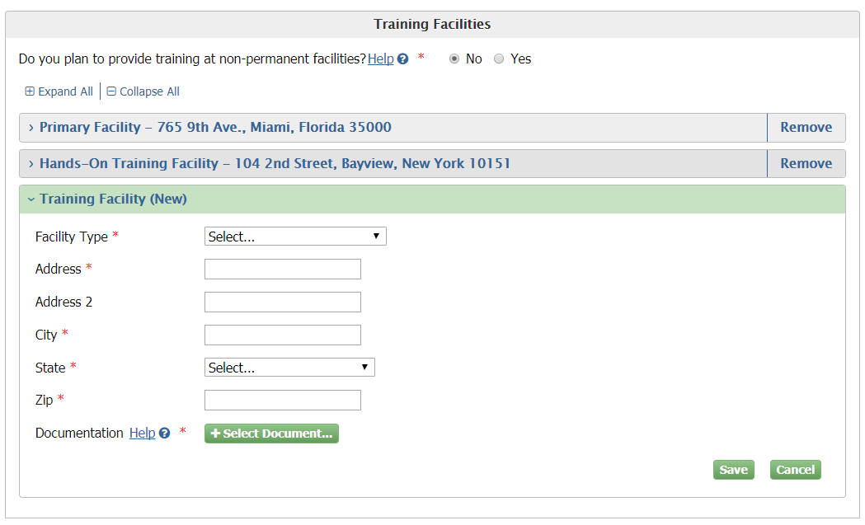
People and Places
Notes:
Clicking the "Add New Training Facility" button will expand the Training Facilities section.

Slide 18
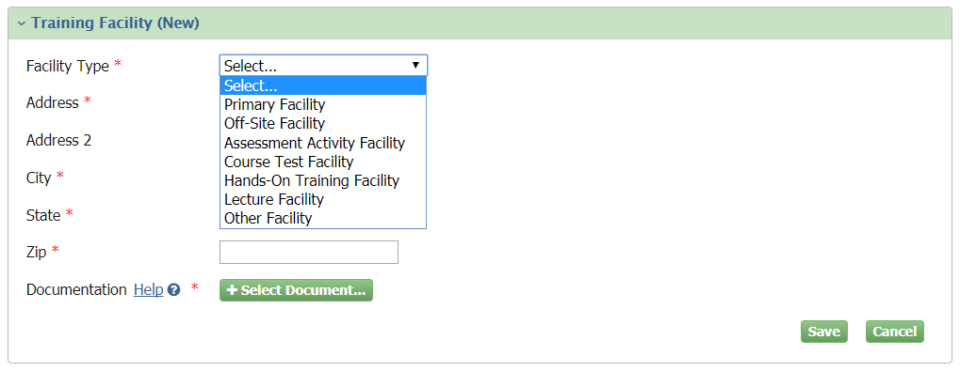
People and Places
Notes:
Users have the ability to choose from multiple Facility Types.

Slide 19
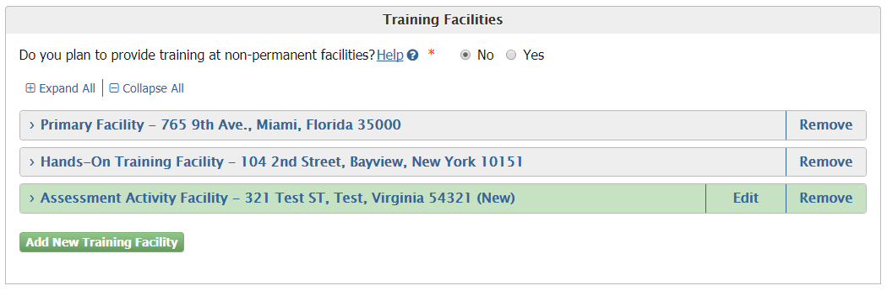
People and Places
Notes:
Saving the Training Facility will collapse the section and display as shown above. Users will have the ability to edit the newly added Training Facility up until the form is submitted. To change submitted Training Facilities information, users will need to submit an amendment removing the old Training Facility and adding the new Facility.

Slide 20
People and Places
Notes:
Clicking "Yes" for the “Do you plan to provide training at non-permanent facilities” will allow the user to submit for accreditation to provide training at non-permanent facilities. The user will be required to upload supporting documentation. Providing information regarding non-permanent training facilities does not require adding additional Training Facilities.

Slide 21
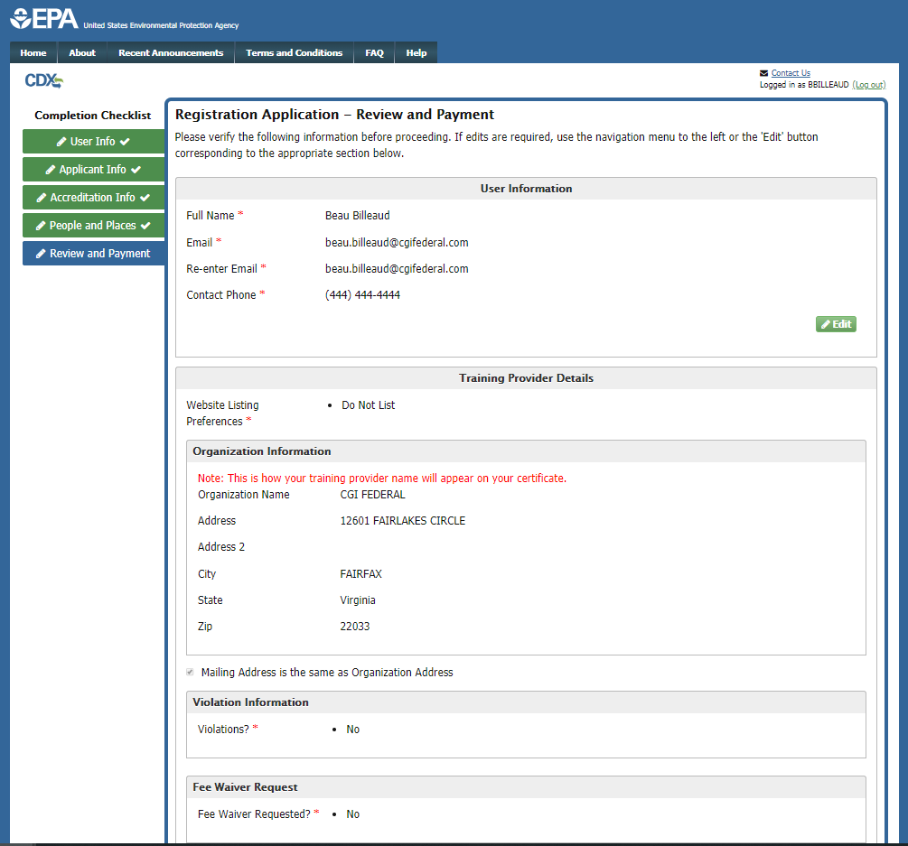
Review and Payment
Notes:
On the Review and Payment page, verify that the information displayed in read-only format is correct and complete. If any changes are required, click the “Edit” button next to the appropriate section on the page.

Slide 22
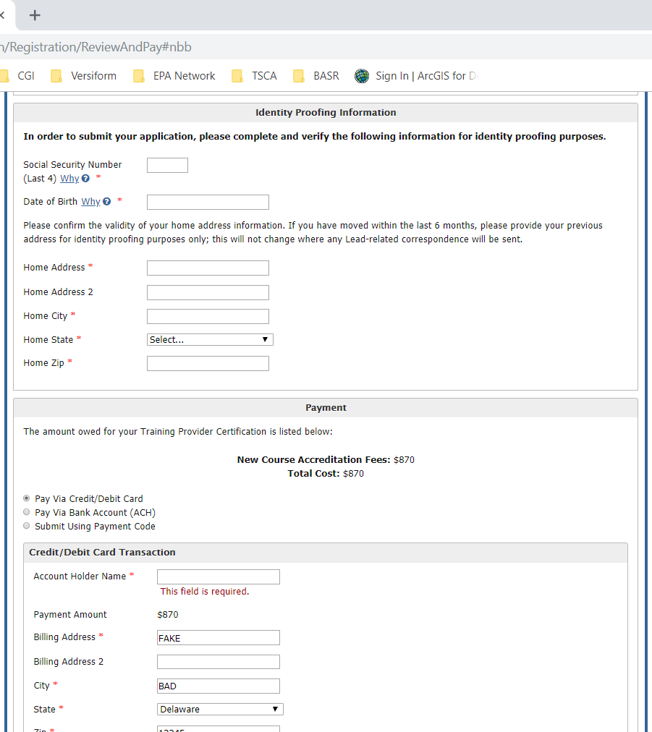
Review and Payment
Notes:
At the bottom of the Review and Payment screen, complete the Identity Proofing Information section. Enter the last four digits of your SSN and your date of birth, and confirm the validity of your home address. In the payment section, the total cost of your application is displayed in the Payment section. You may select to pay this amount either by credit or debit card, with a bank account ACH transfer, or with a payment code. Select the appropriate method by clicking the radio button next to your selection.

Slide 23
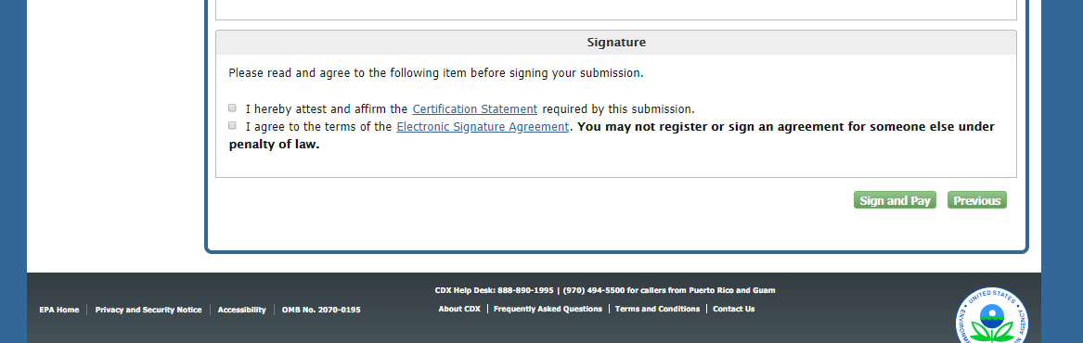
Certification
Notes:
The last section on the Review and Payment page is the Certification section. Before submitting, click the link to open and carefully read the Certification Statement. Clicking the link to the Electronic Signature Agreement will display the full text of the document. Select the check boxes to affirm your acceptance of the terms before clicking the “Sign and Pay” button.

Slide 24
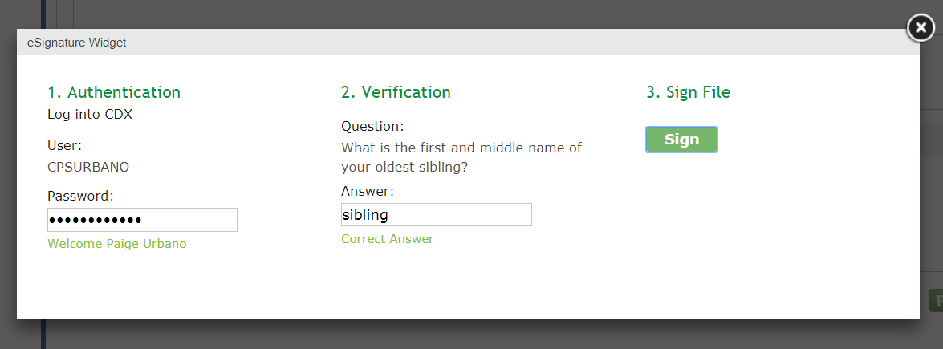
eSignature Widget
Notes:
To complete your submission, you will have to provide the correct CDX password for the account, answer a verification security question and click "Sign" within the eSignature Widget.

Slide 25
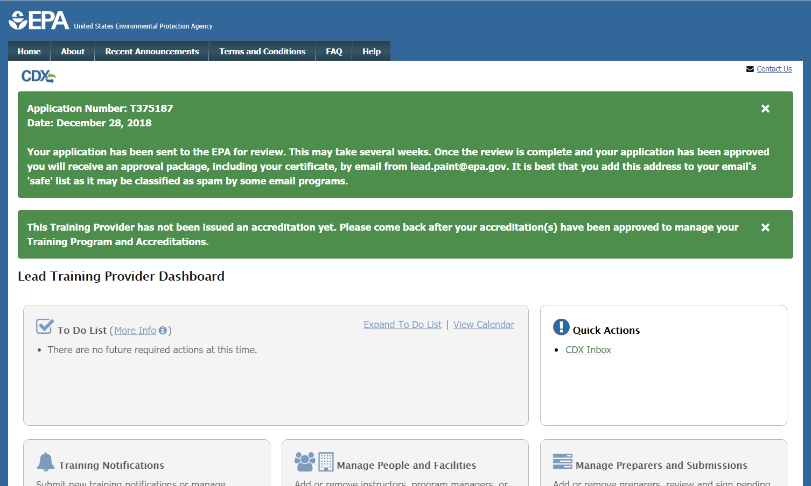
Application Submission Confirmation
Notes:
Once your application is complete and has been signed, you have completed the process. On this page, you will see your application number and the date that your application was signed. Your application will now be reviewed by EPA. Once the review is complete, you will receive a confirmation email from EPA with details.

Slide 26
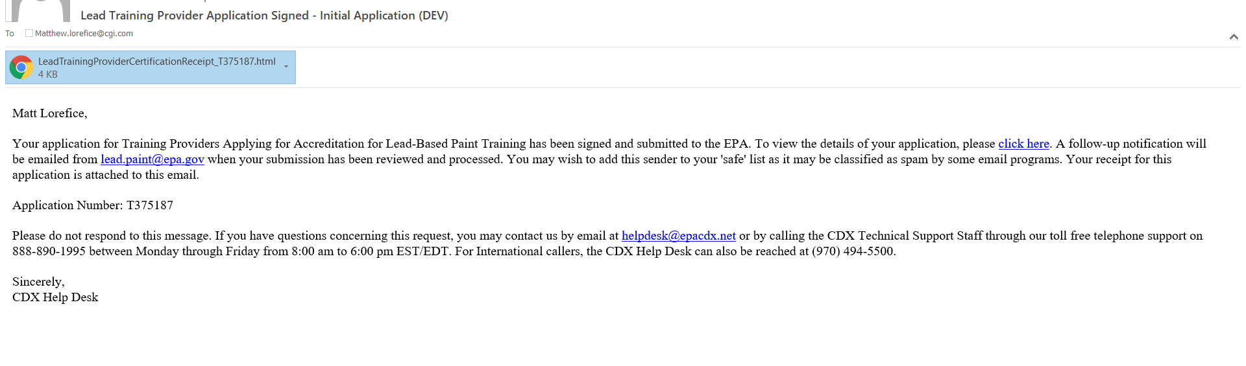
Application Submission Confirmation Email
Notes:
If your application is complete and signed, you will receive an email such as the above to confirm.

